Slide 1







Meriden CE Primary
Wider Curriculum Design

Slide 2


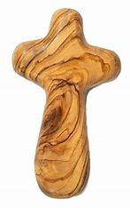

An inspiring education, centred around Friends, Faith and Lifelong Learning.
Friends
To nurture healthy relationships and enable our pupils to be positive contributors in a multicultural society.
To develop a strong sense of morality in our pupils.
Faith
To value all as a gift from God where each individual has the opportunity to explore their own potential and purpose.
To offer a diverse education that has its foundations in the Christian faith.
Lifelong Learning
To develop a love of learning through a vibrant and inclusive curriculum which actively enables all children to reach their full potential.
To equip all pupils with the appropriate knowledge, skills and understanding required to succeed in life.

Slide 3

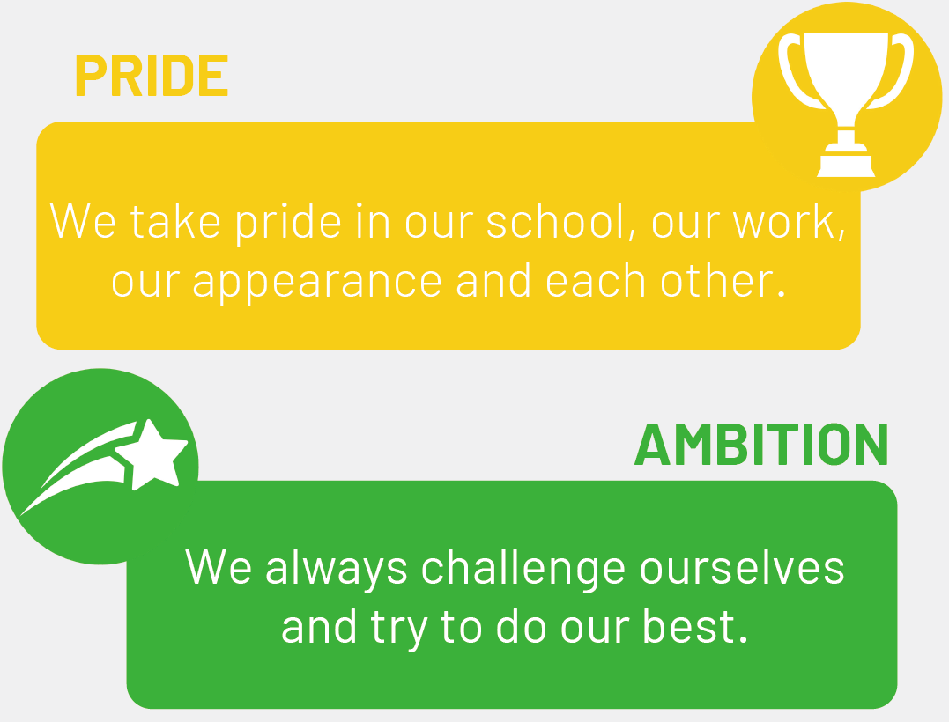

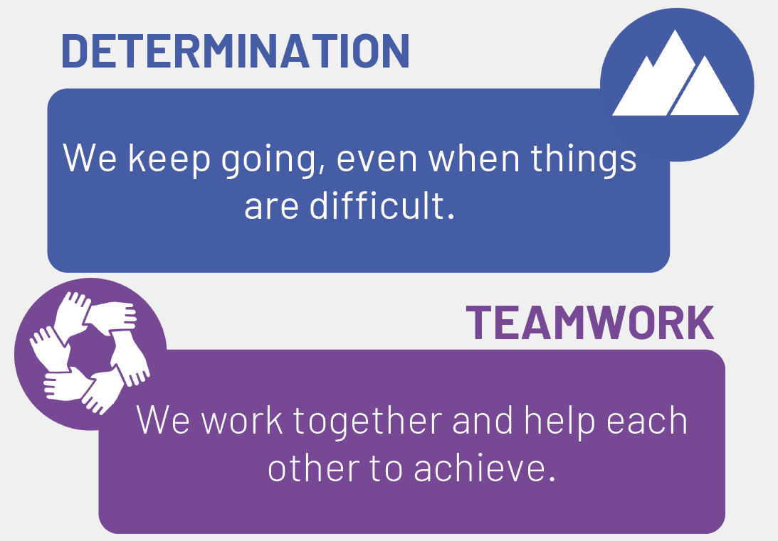

Meriden CE Primary
Our Values

Slide 4
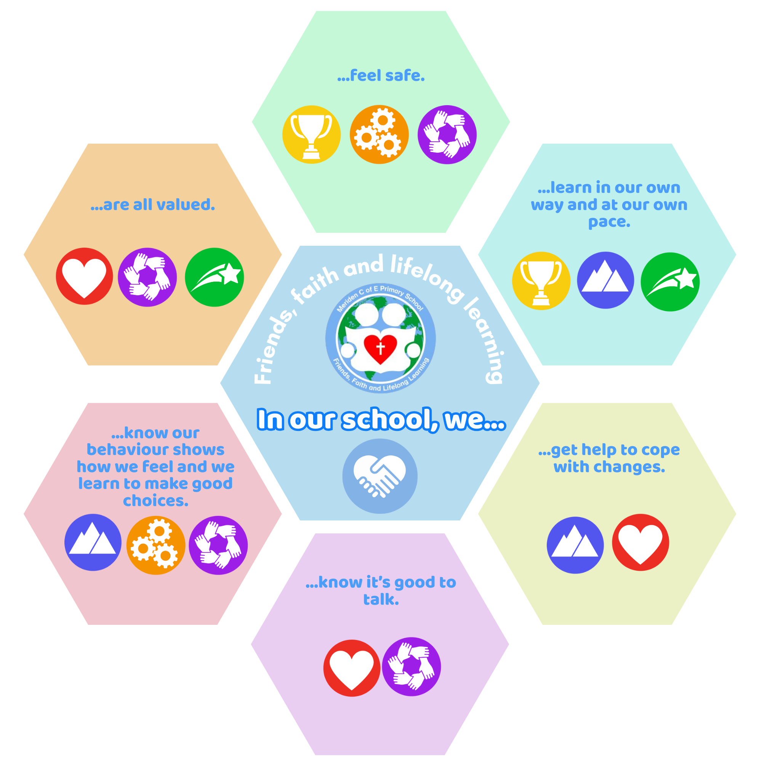
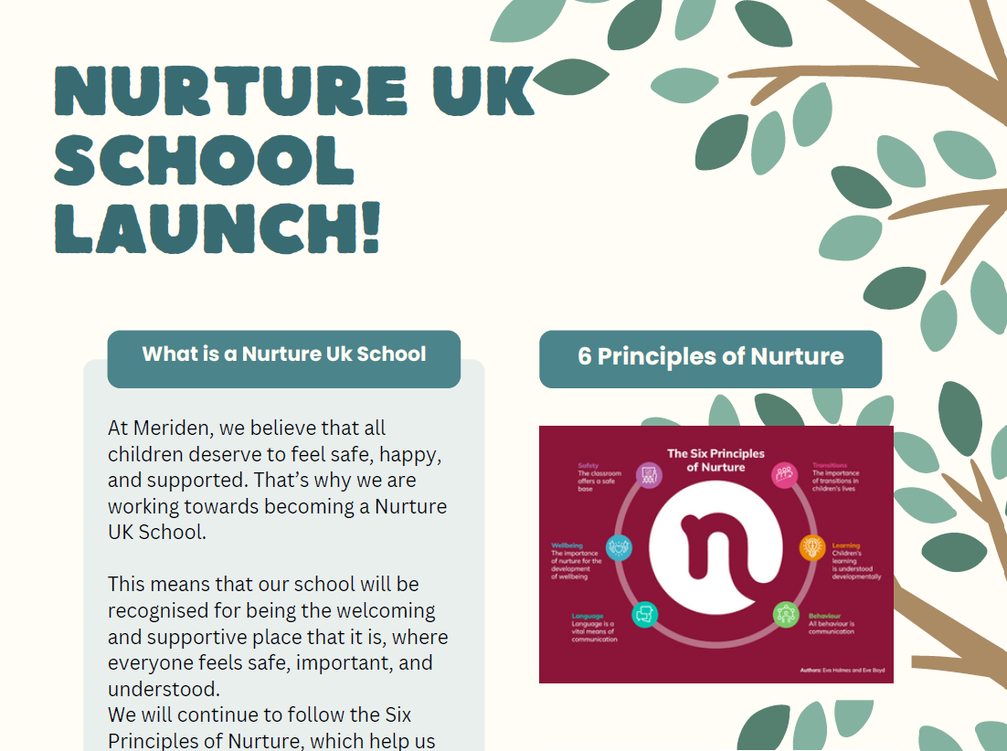
Meriden CE Primary
6 Principles of Nurture

Slide 5
Friends, Faith and Lifelong Learning
In our school, we…
… feel safe
…are all valued
… learn in our own way and at our own pace
… know it’s good to talk
… get help to cope with changes
… know our behaviour shows our feelings and we learn to make good choices

Slide 6

… feel safe
…are all valued
… learn in our own way and at our own pace
… know it’s good to talk
… get help to cope with changes
… know our behaviour shows our feelings and we learn to make good choices
Nurture UK
Jigsaw PSHE
Online safety- computing
FSW direct work
Kiva antibullying programme
Celebration assembly
School Council
Worship Team
RE curriculum
ECO team
Community outreach
Picture News
ICON school
EYFS curriculum/unit
Enrichment learning sessions
Swimming
Use of IT to enhance lessons
Curriculum pledge
Curriculum design
Adaptive teaching
Nurture hub afternoons
Positive behaviour sessions
Bespoke 1:1 work
Oracy
Language Link EYFS programmes
SOLAR/mental health teams
Young Carers
Prem-Aware work
Coffee Mornings
Transition work
Routines and visual timetables
SEND reasonable adjustments
Calm corner
Sensory circuits
Colour monster
Zones of Regulation
Behaviour policy
Nurture UK
Life skills timetable
Golden Time

Slide 7

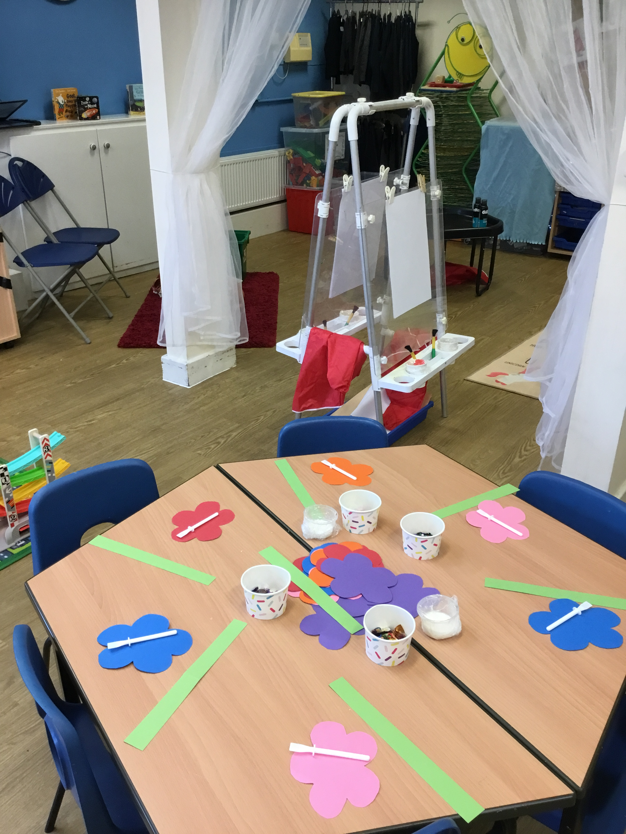
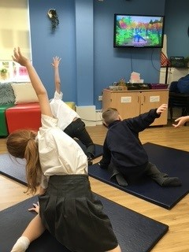
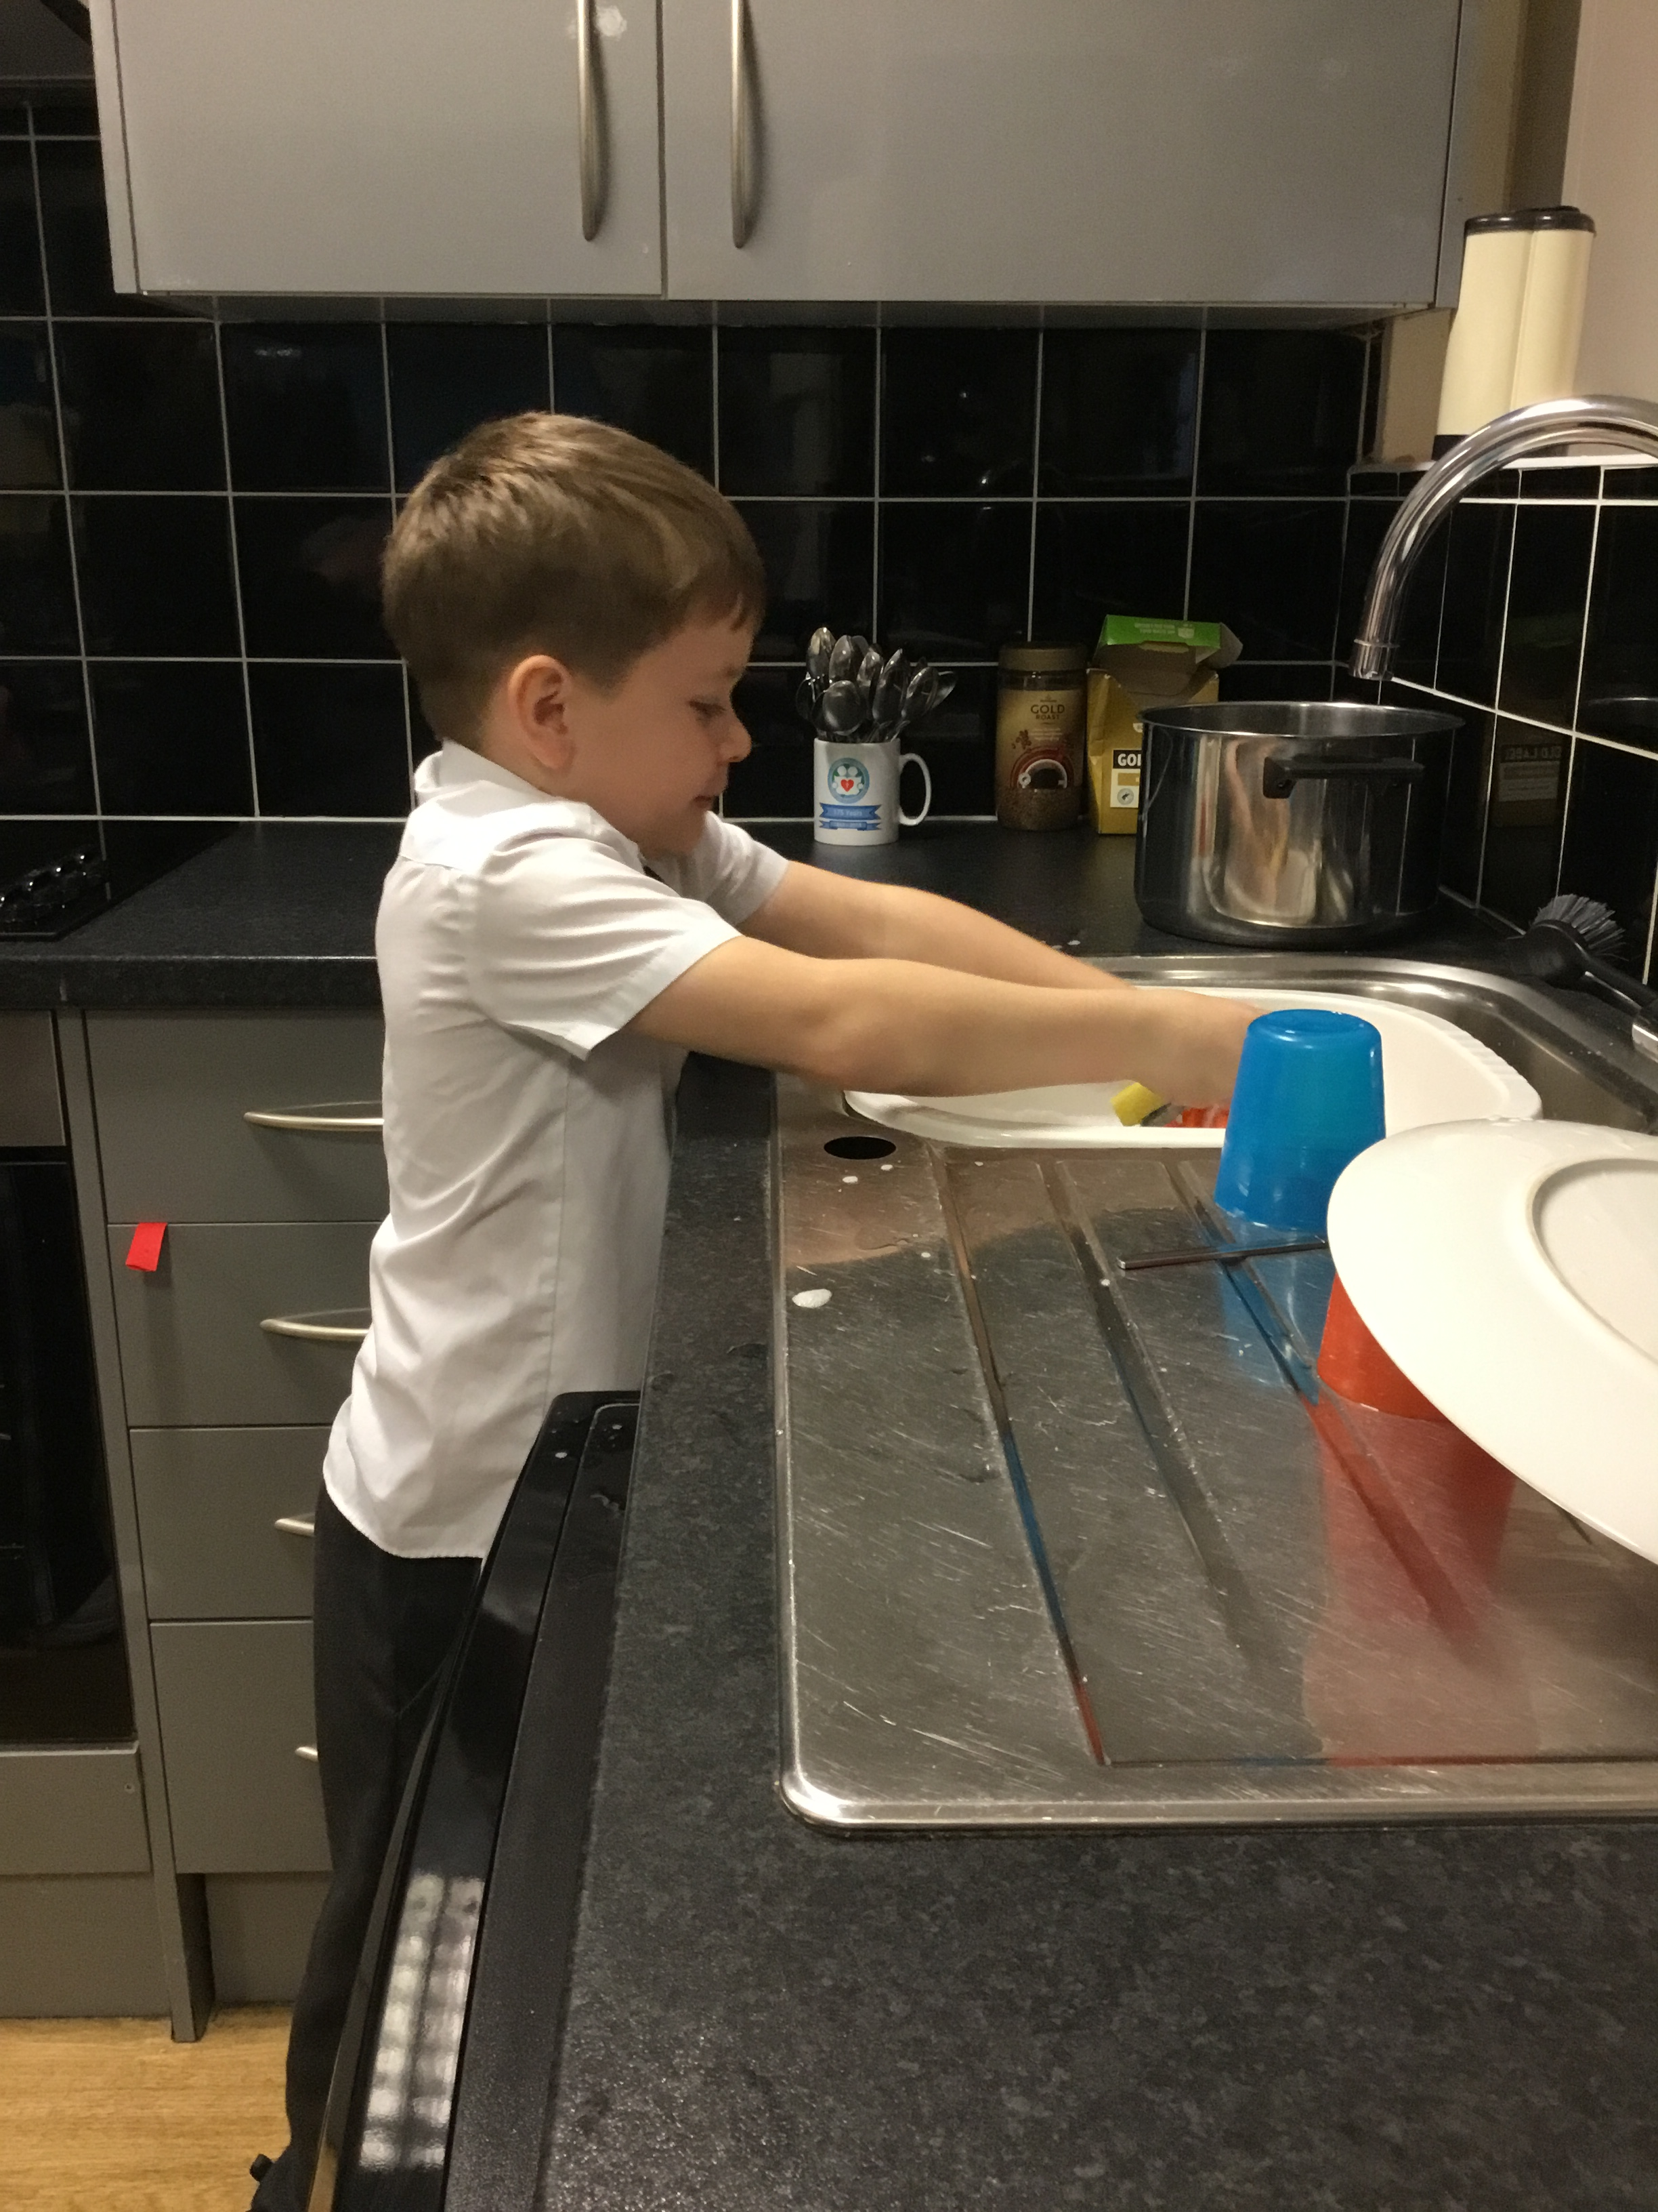
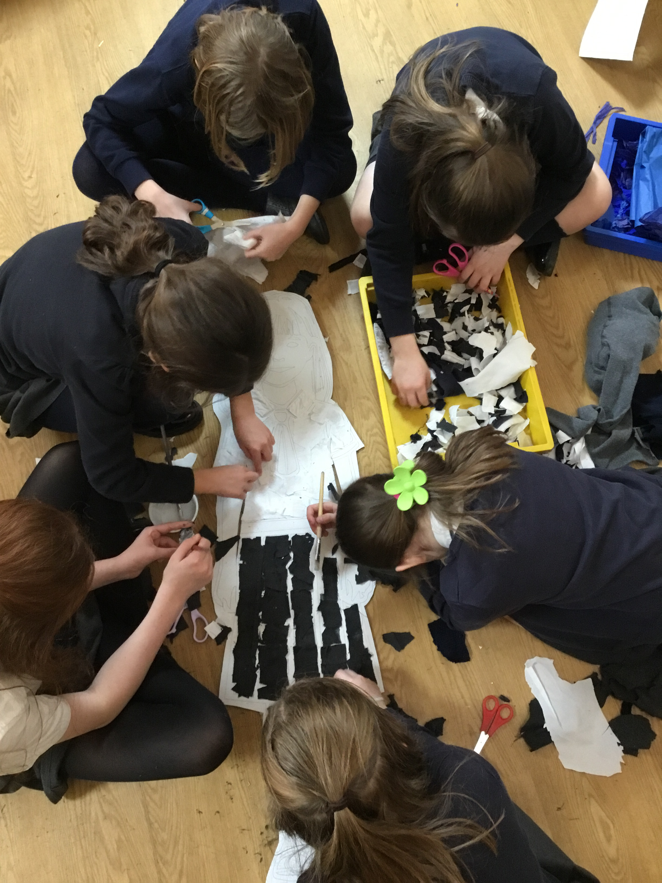
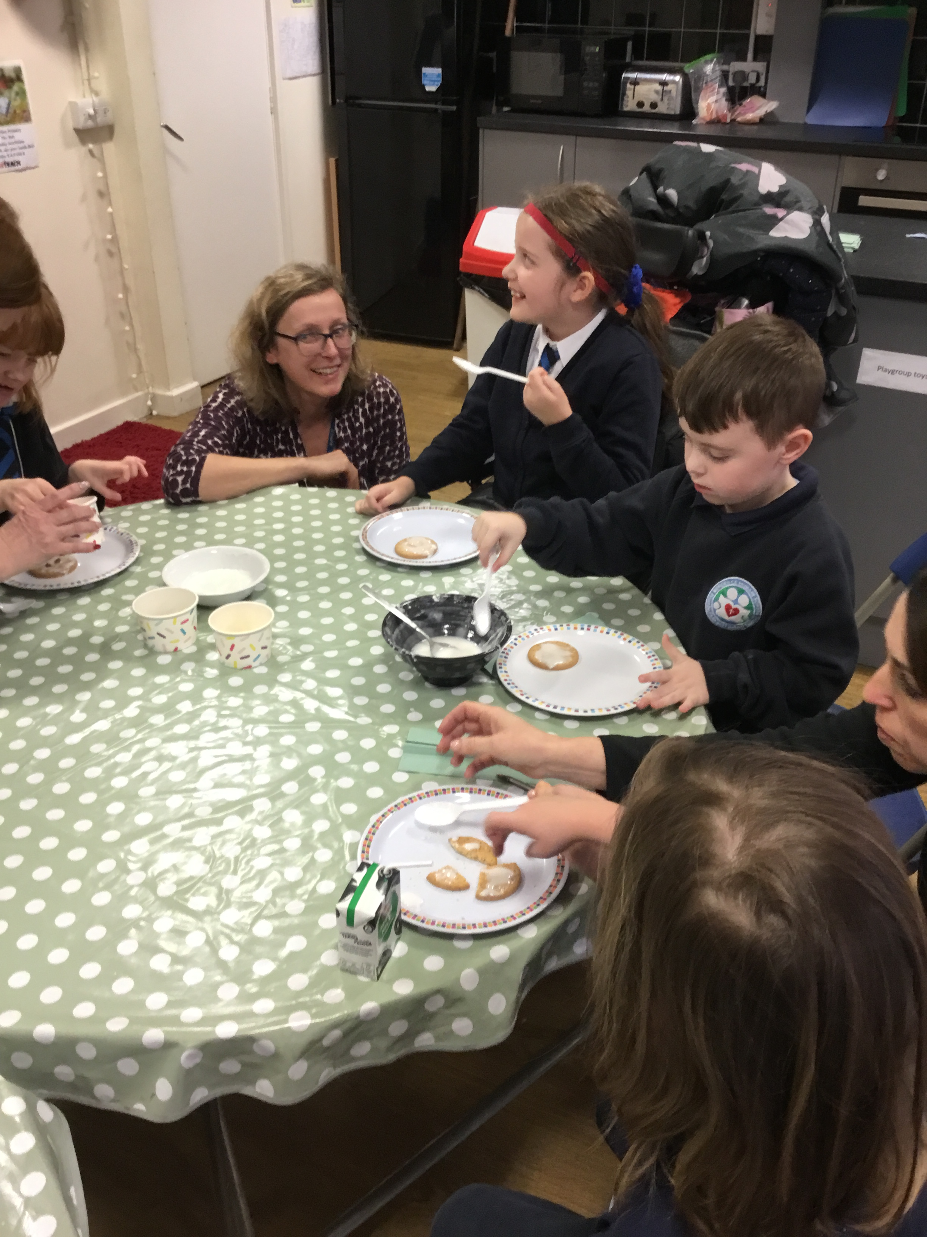
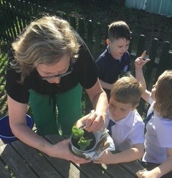
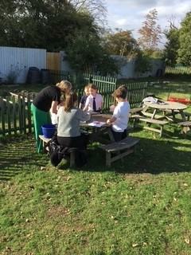
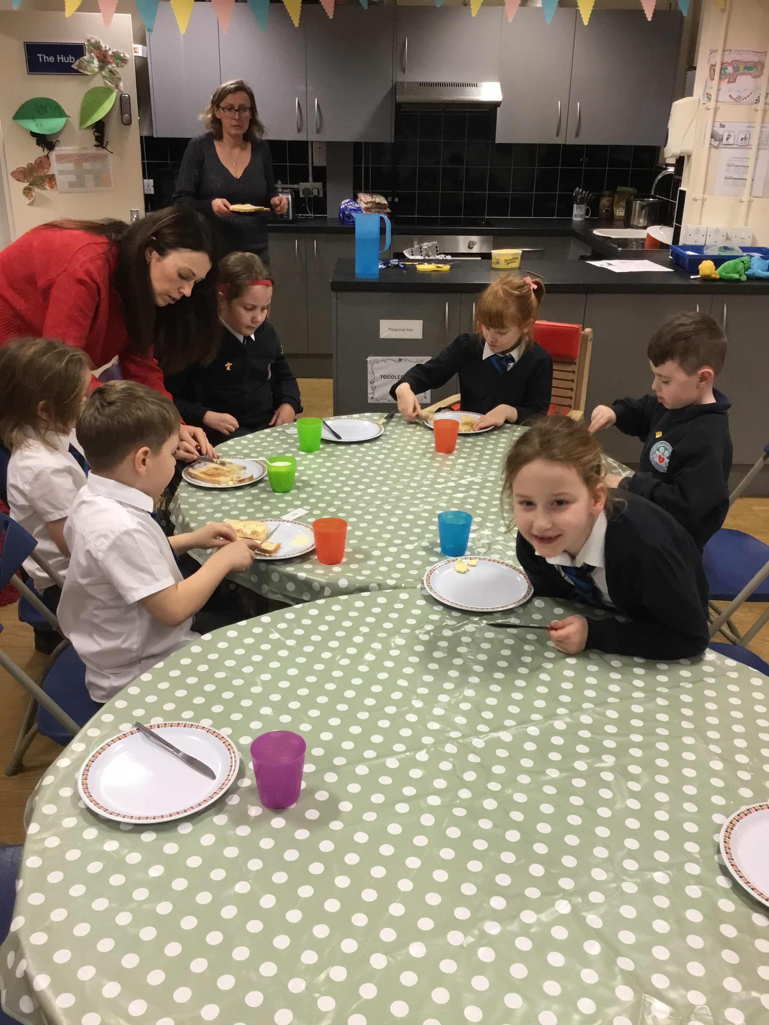
Nurture Hub- Afternoon life-skills

Slide 8

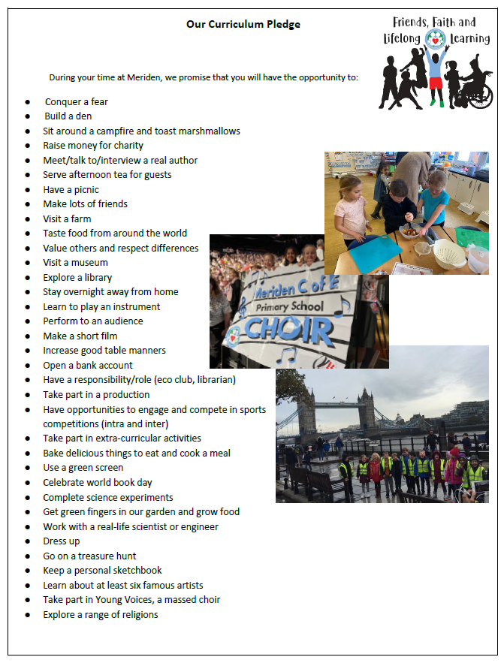
Curriculum Pledge

Slide 9
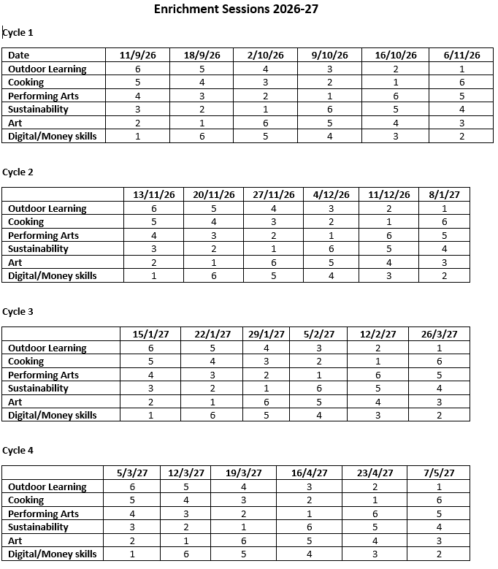
Enrichment

Slide 10
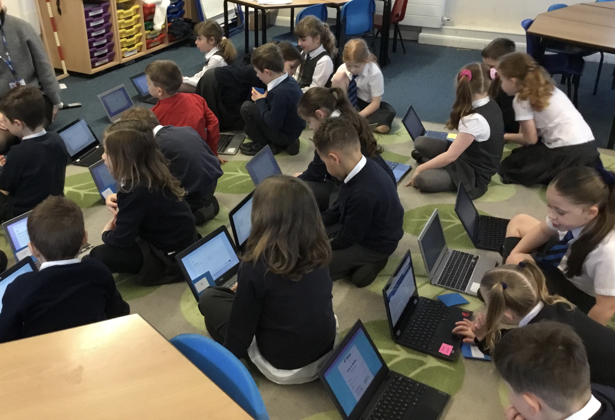
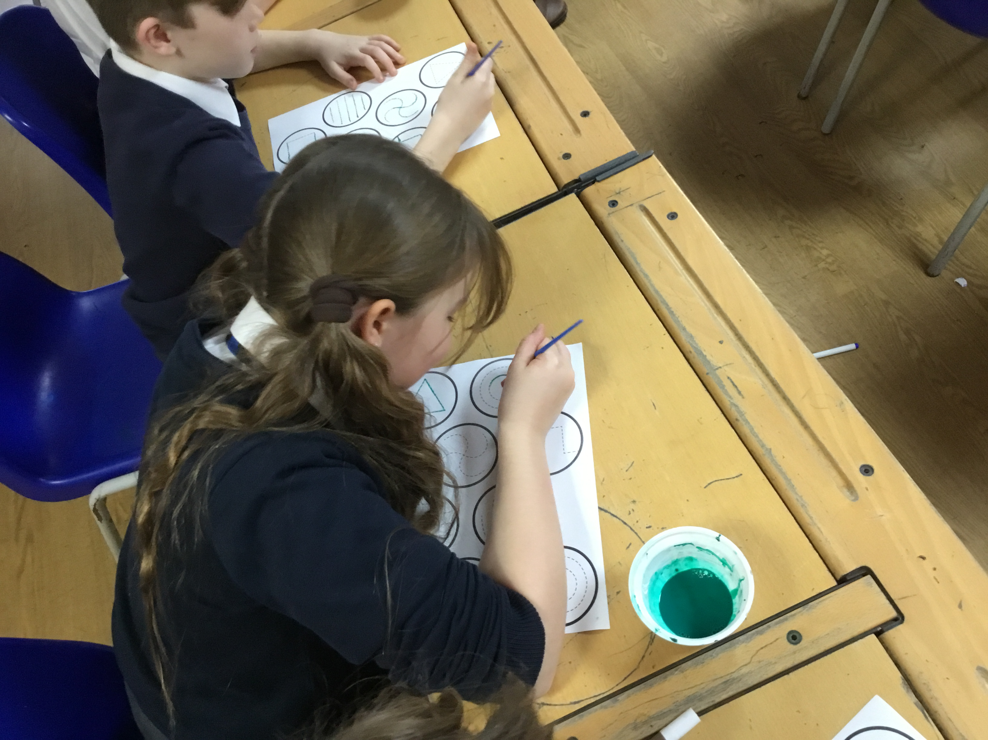
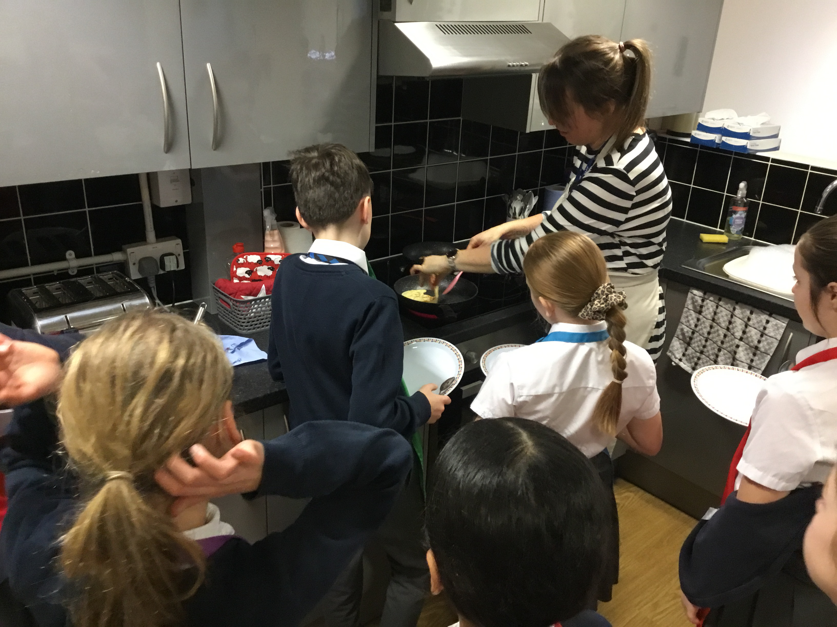
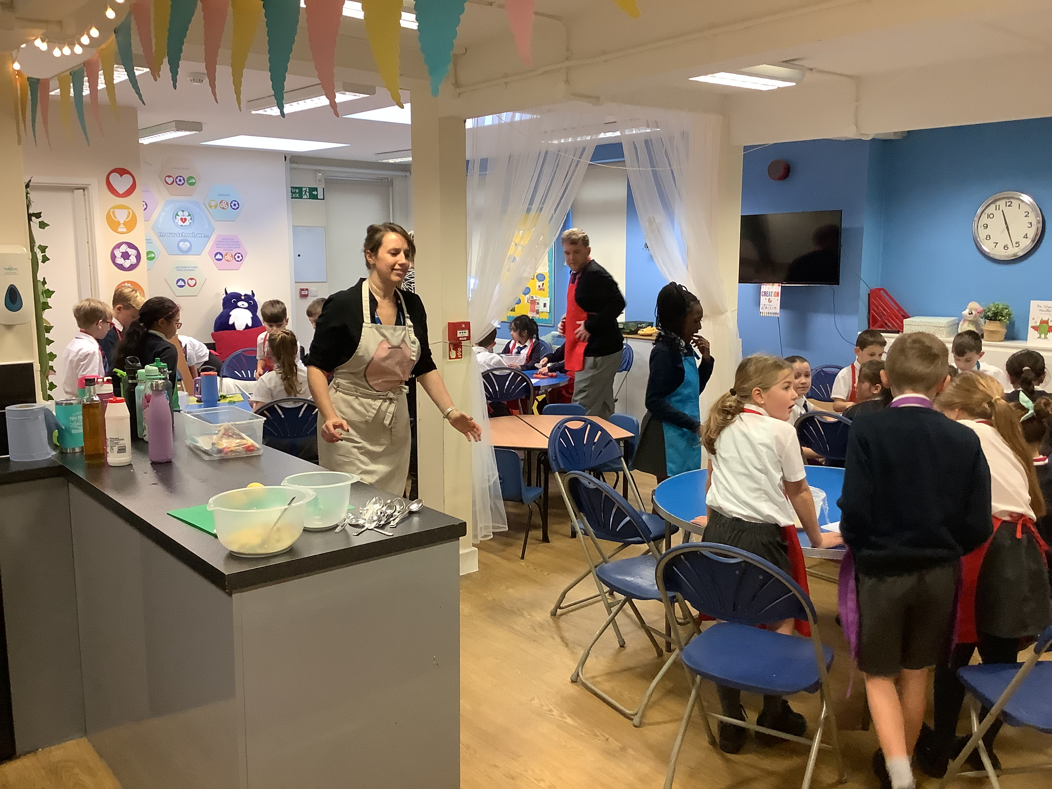
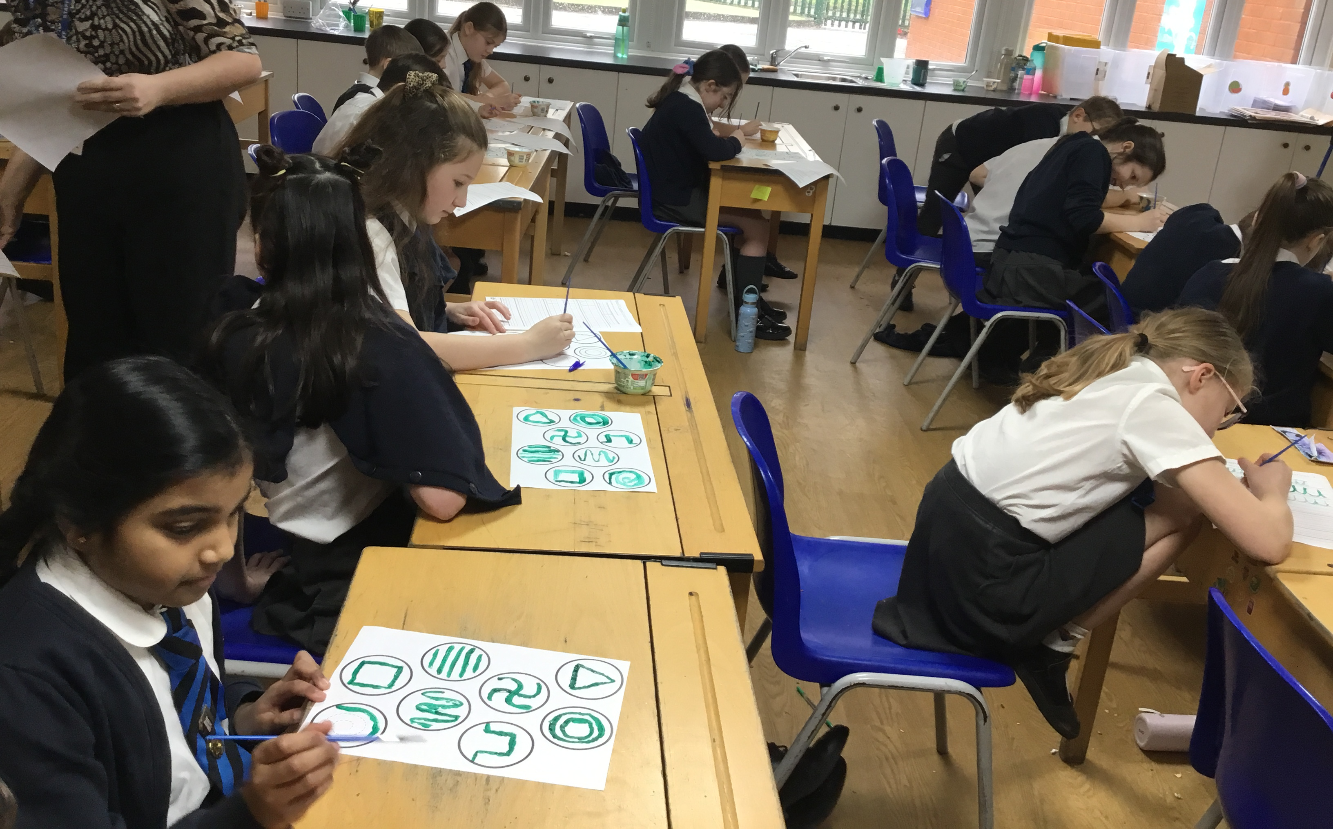
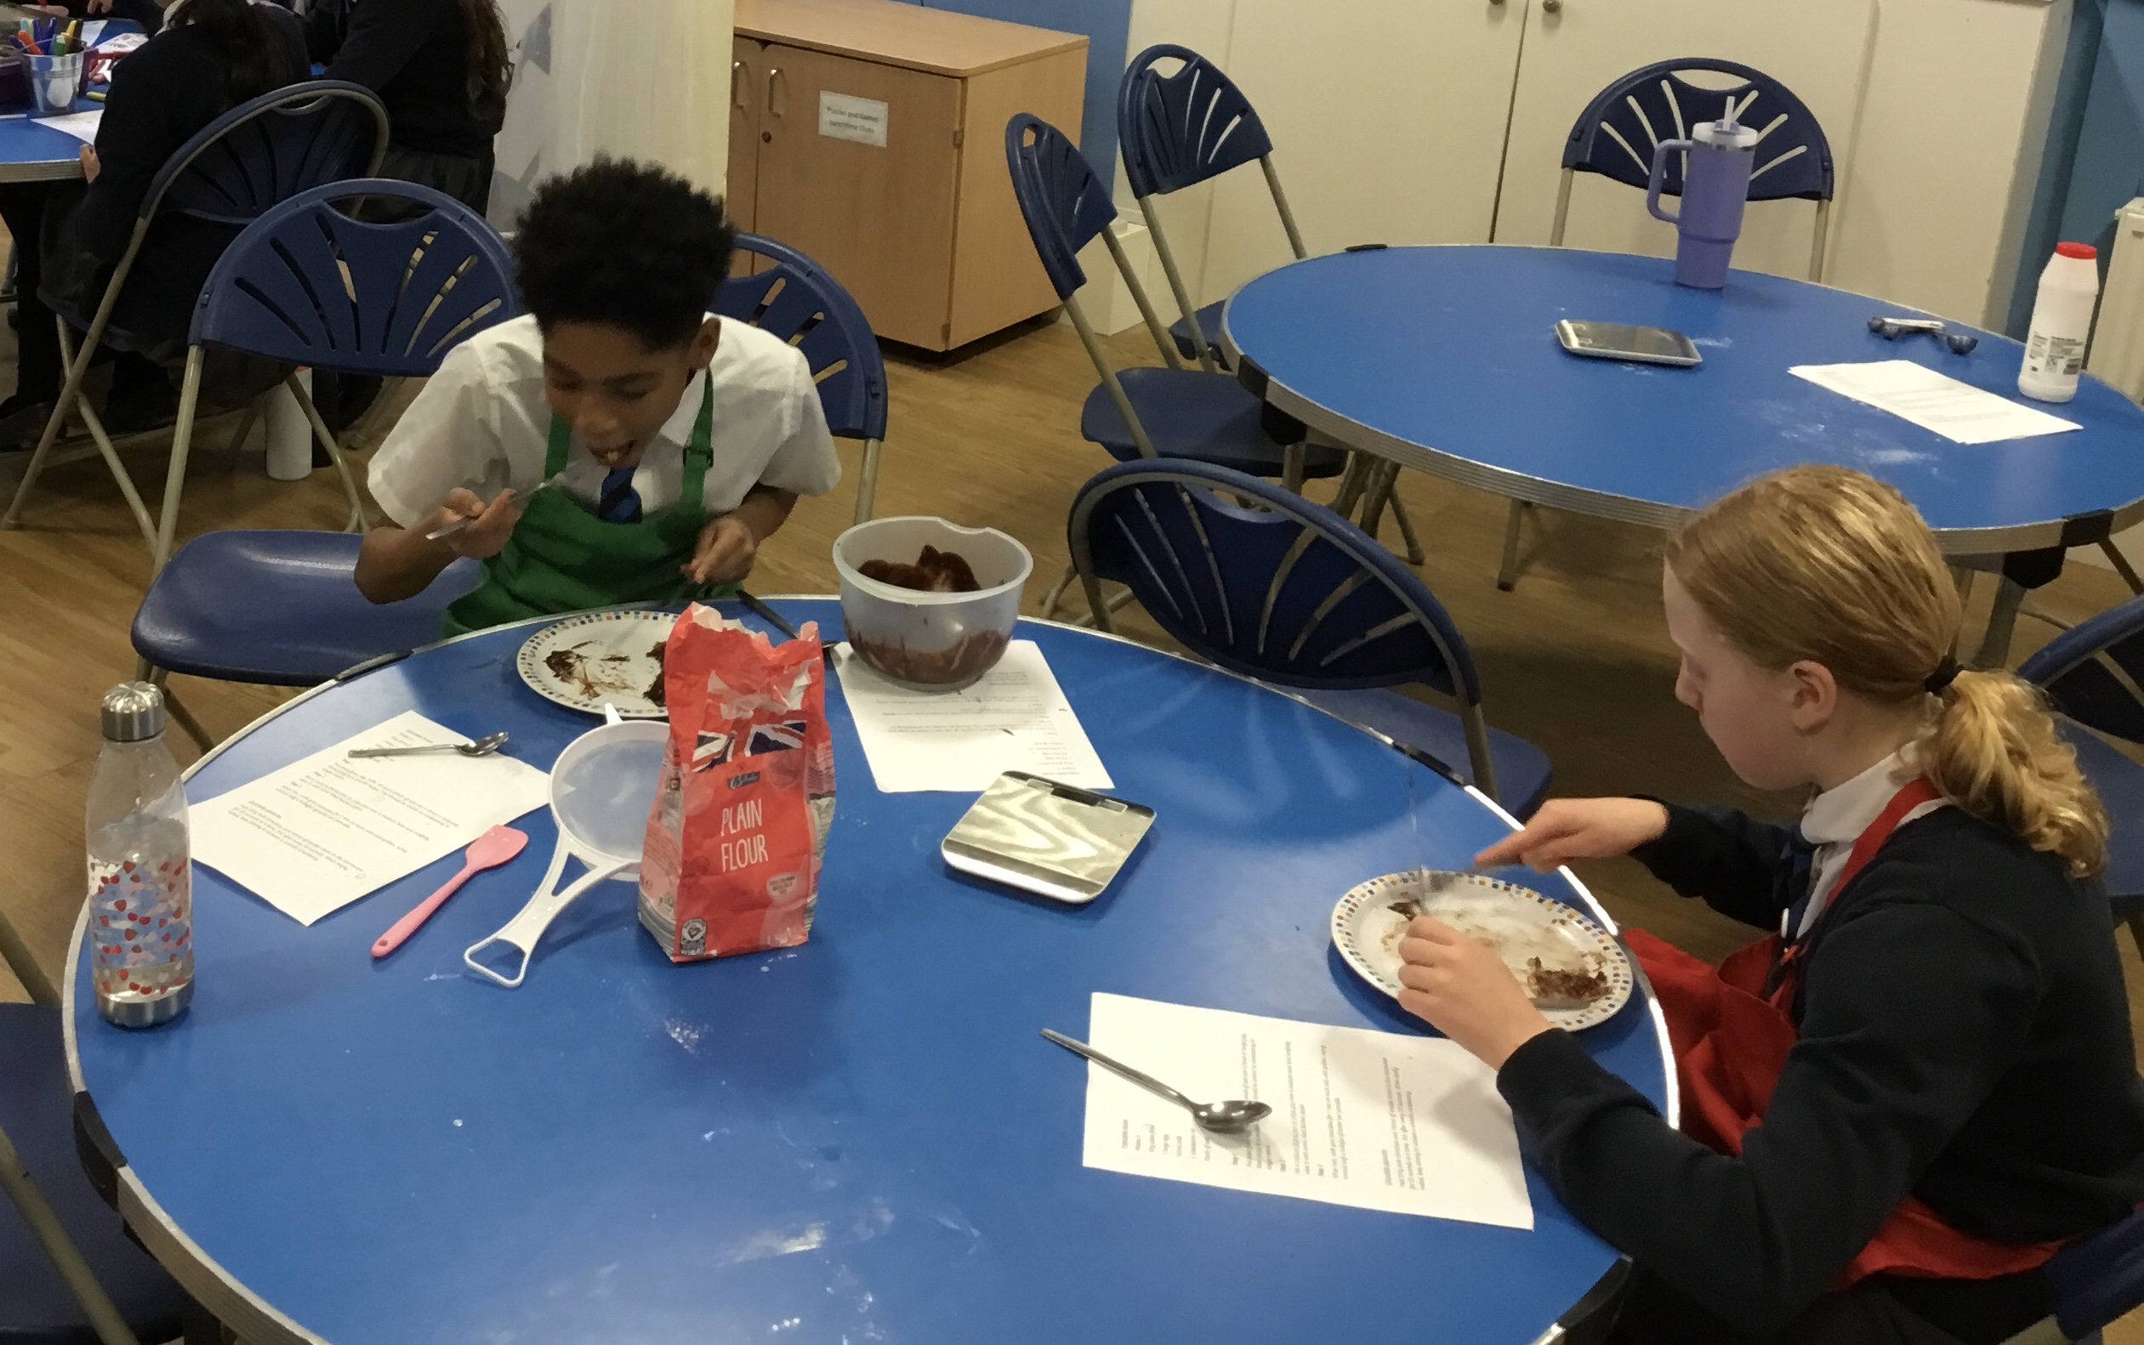

Slide 11
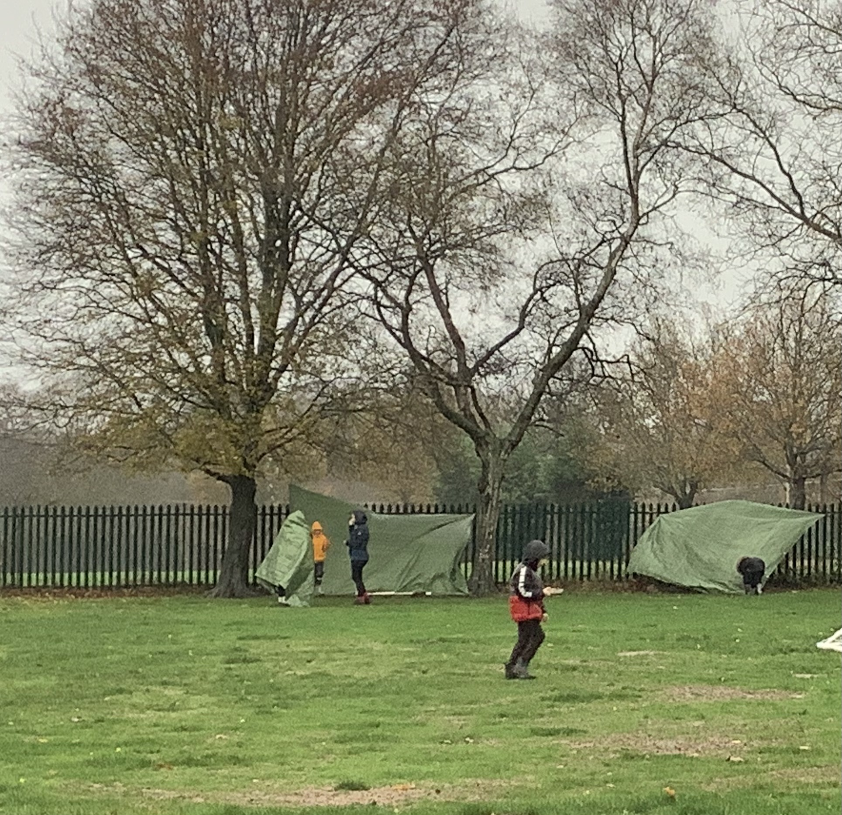
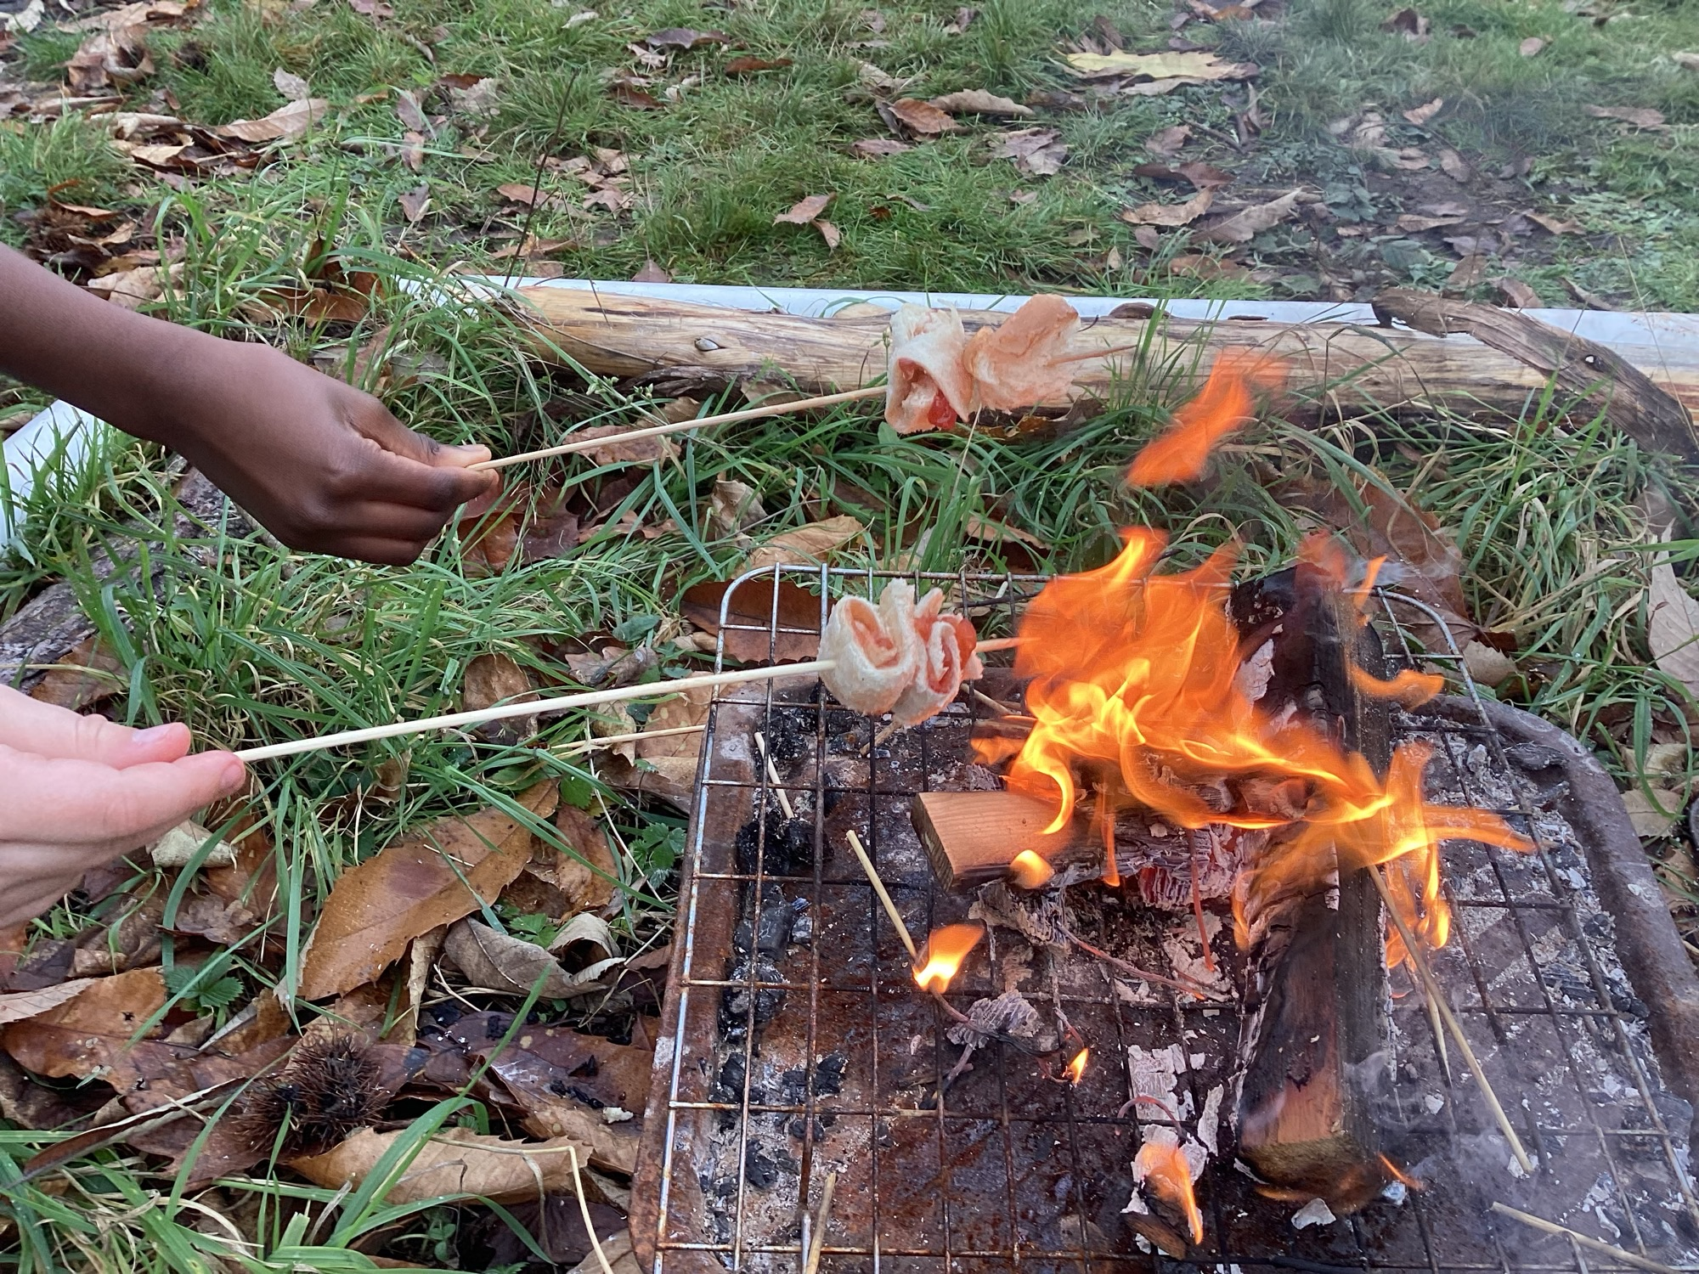
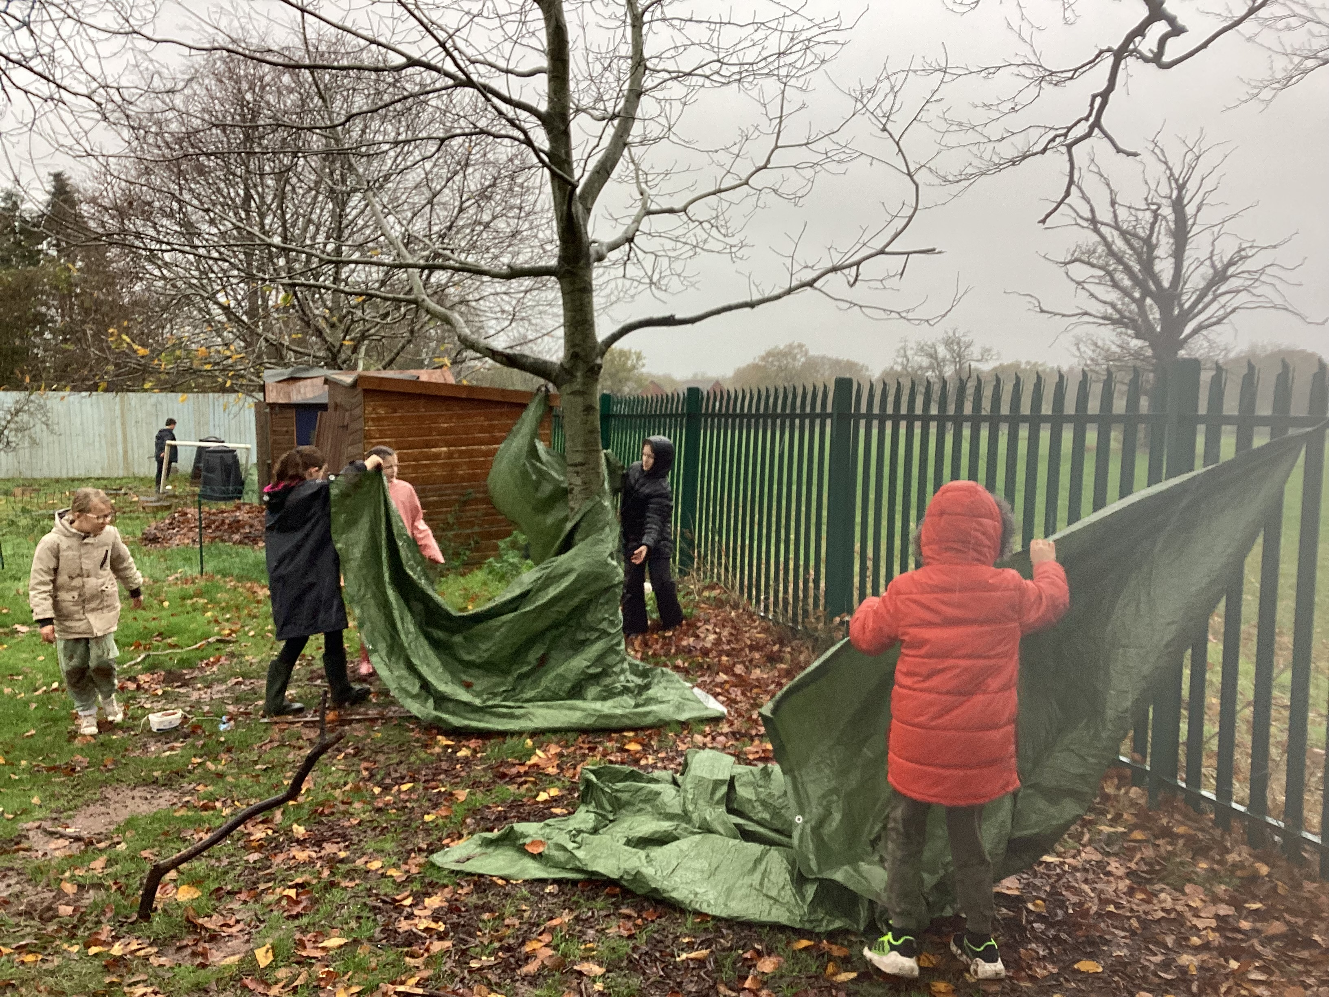
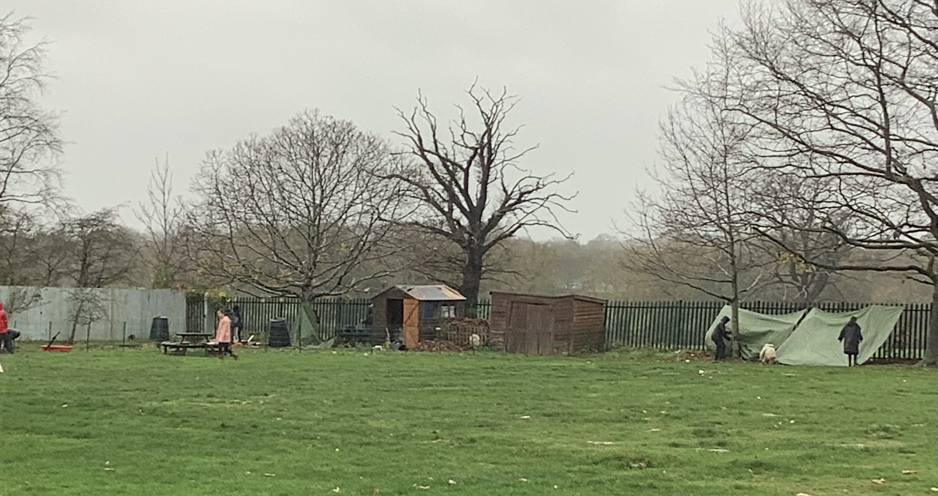
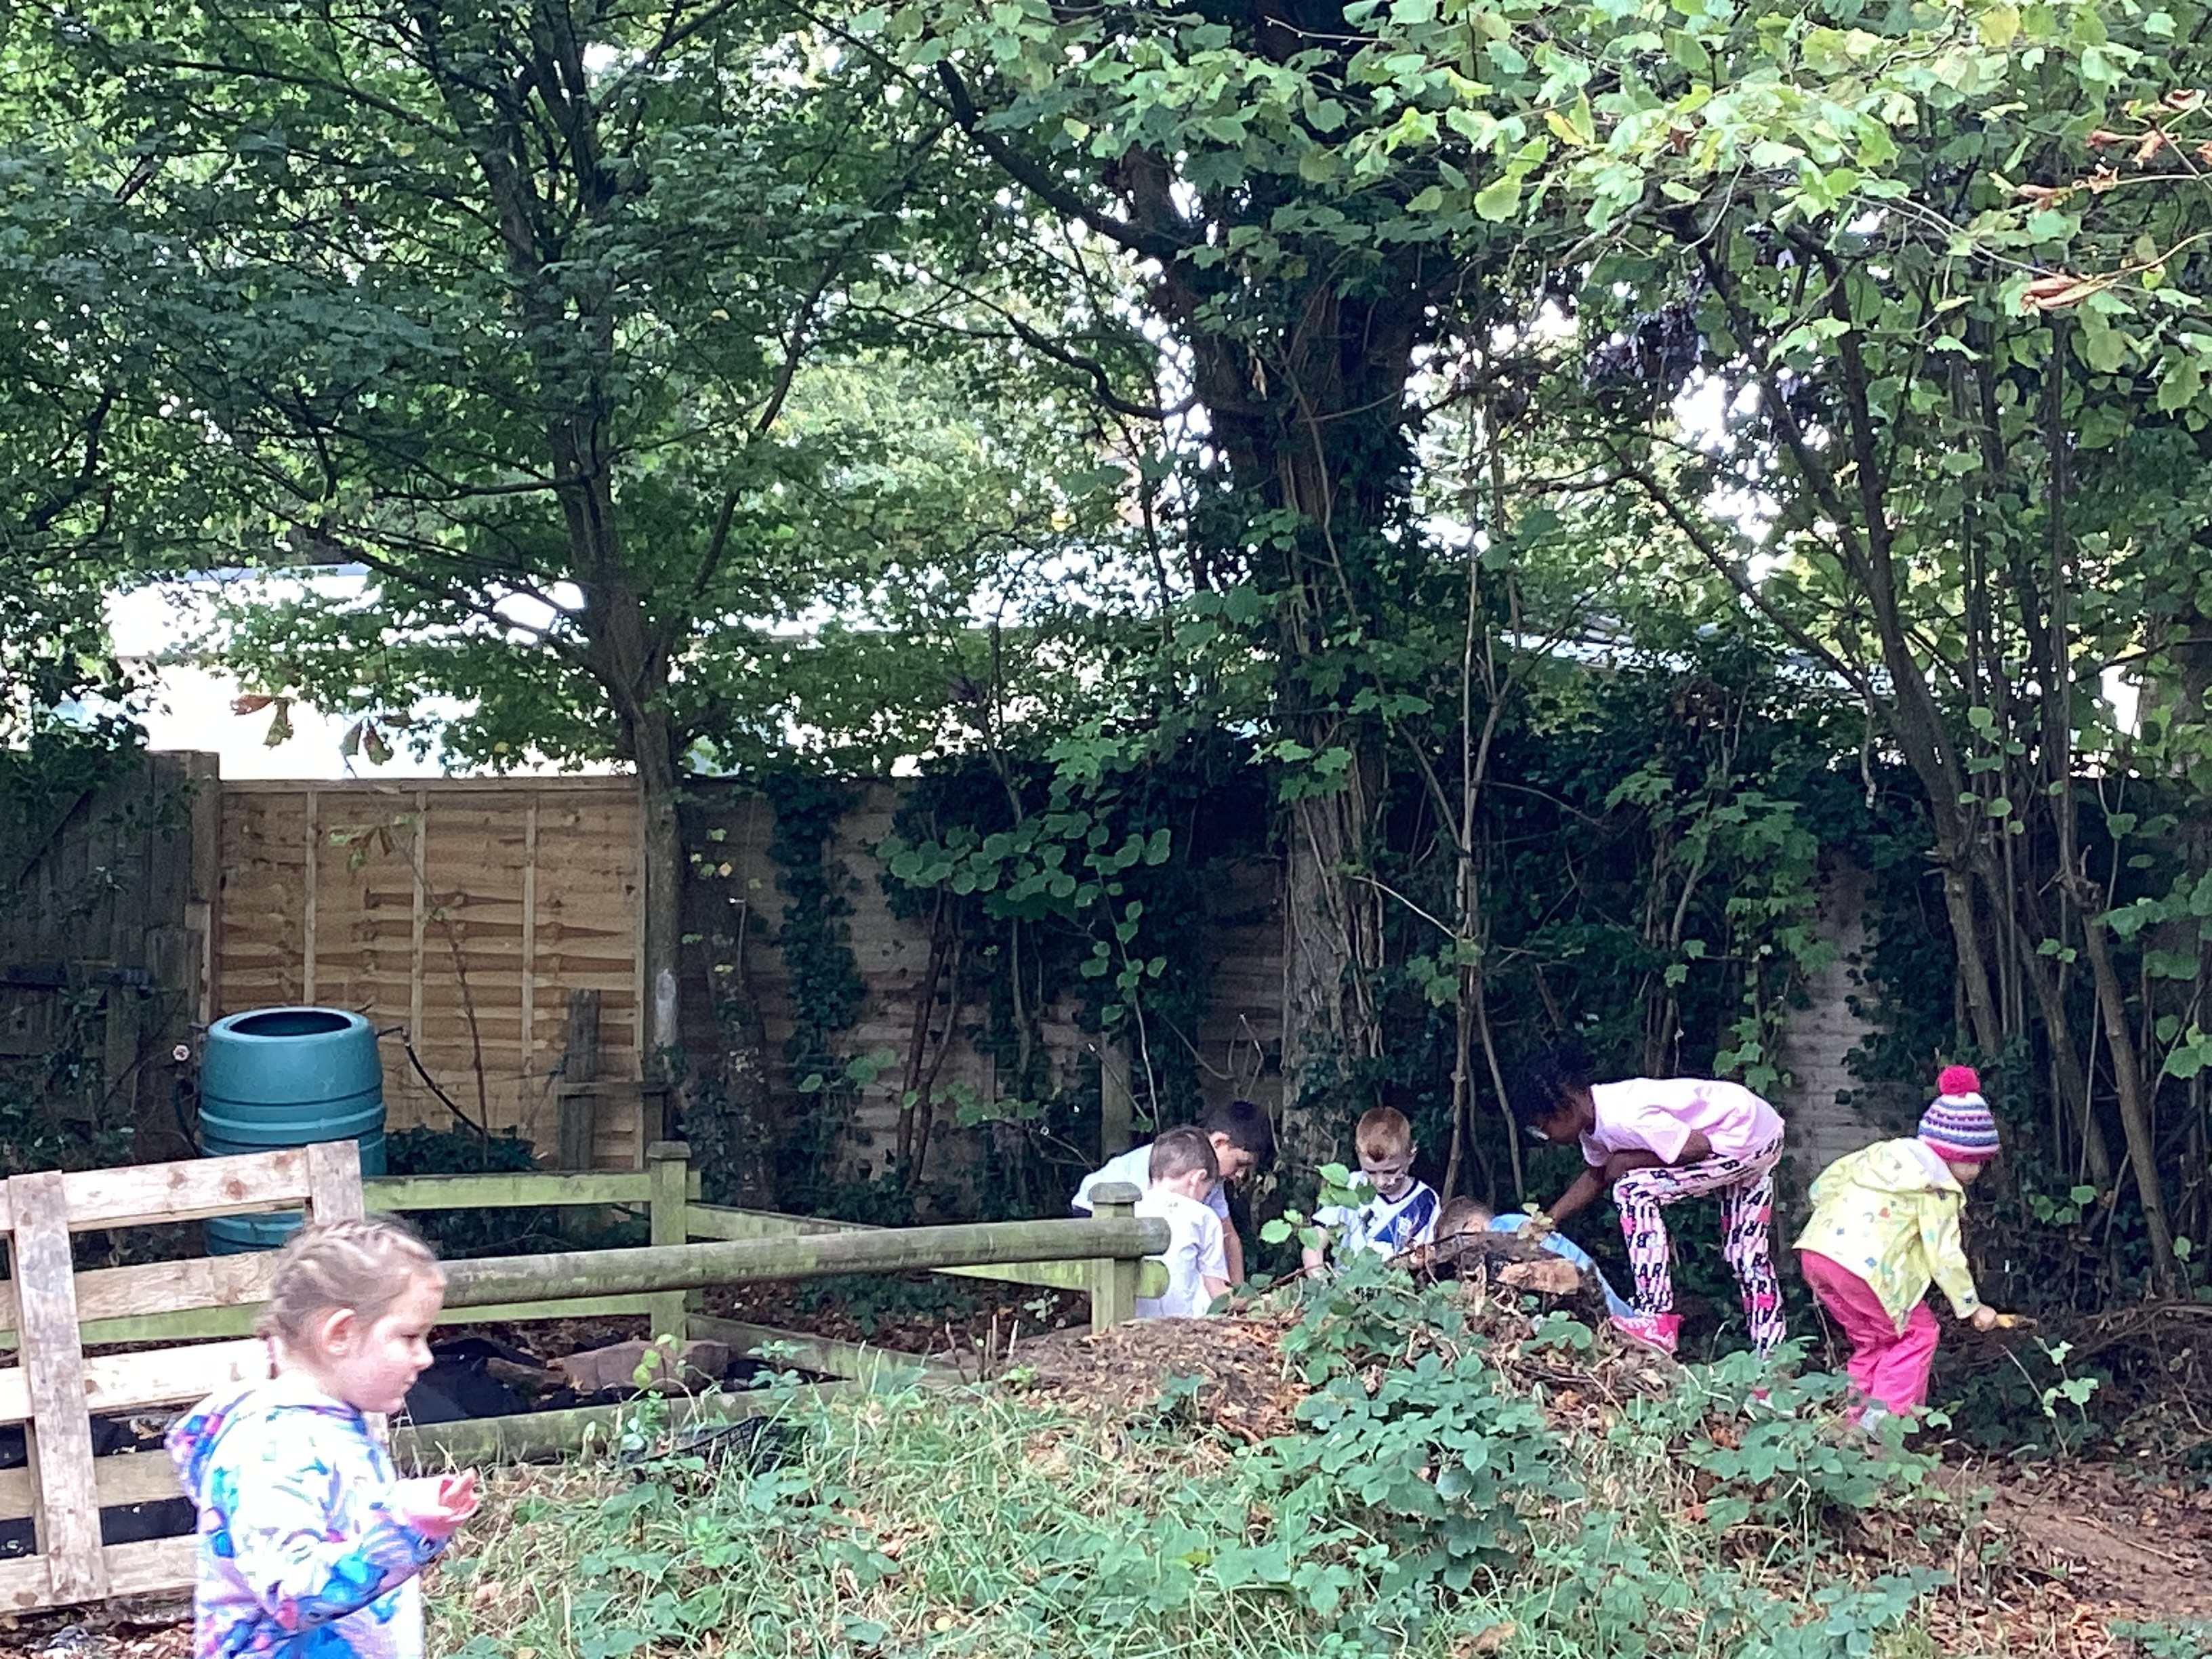
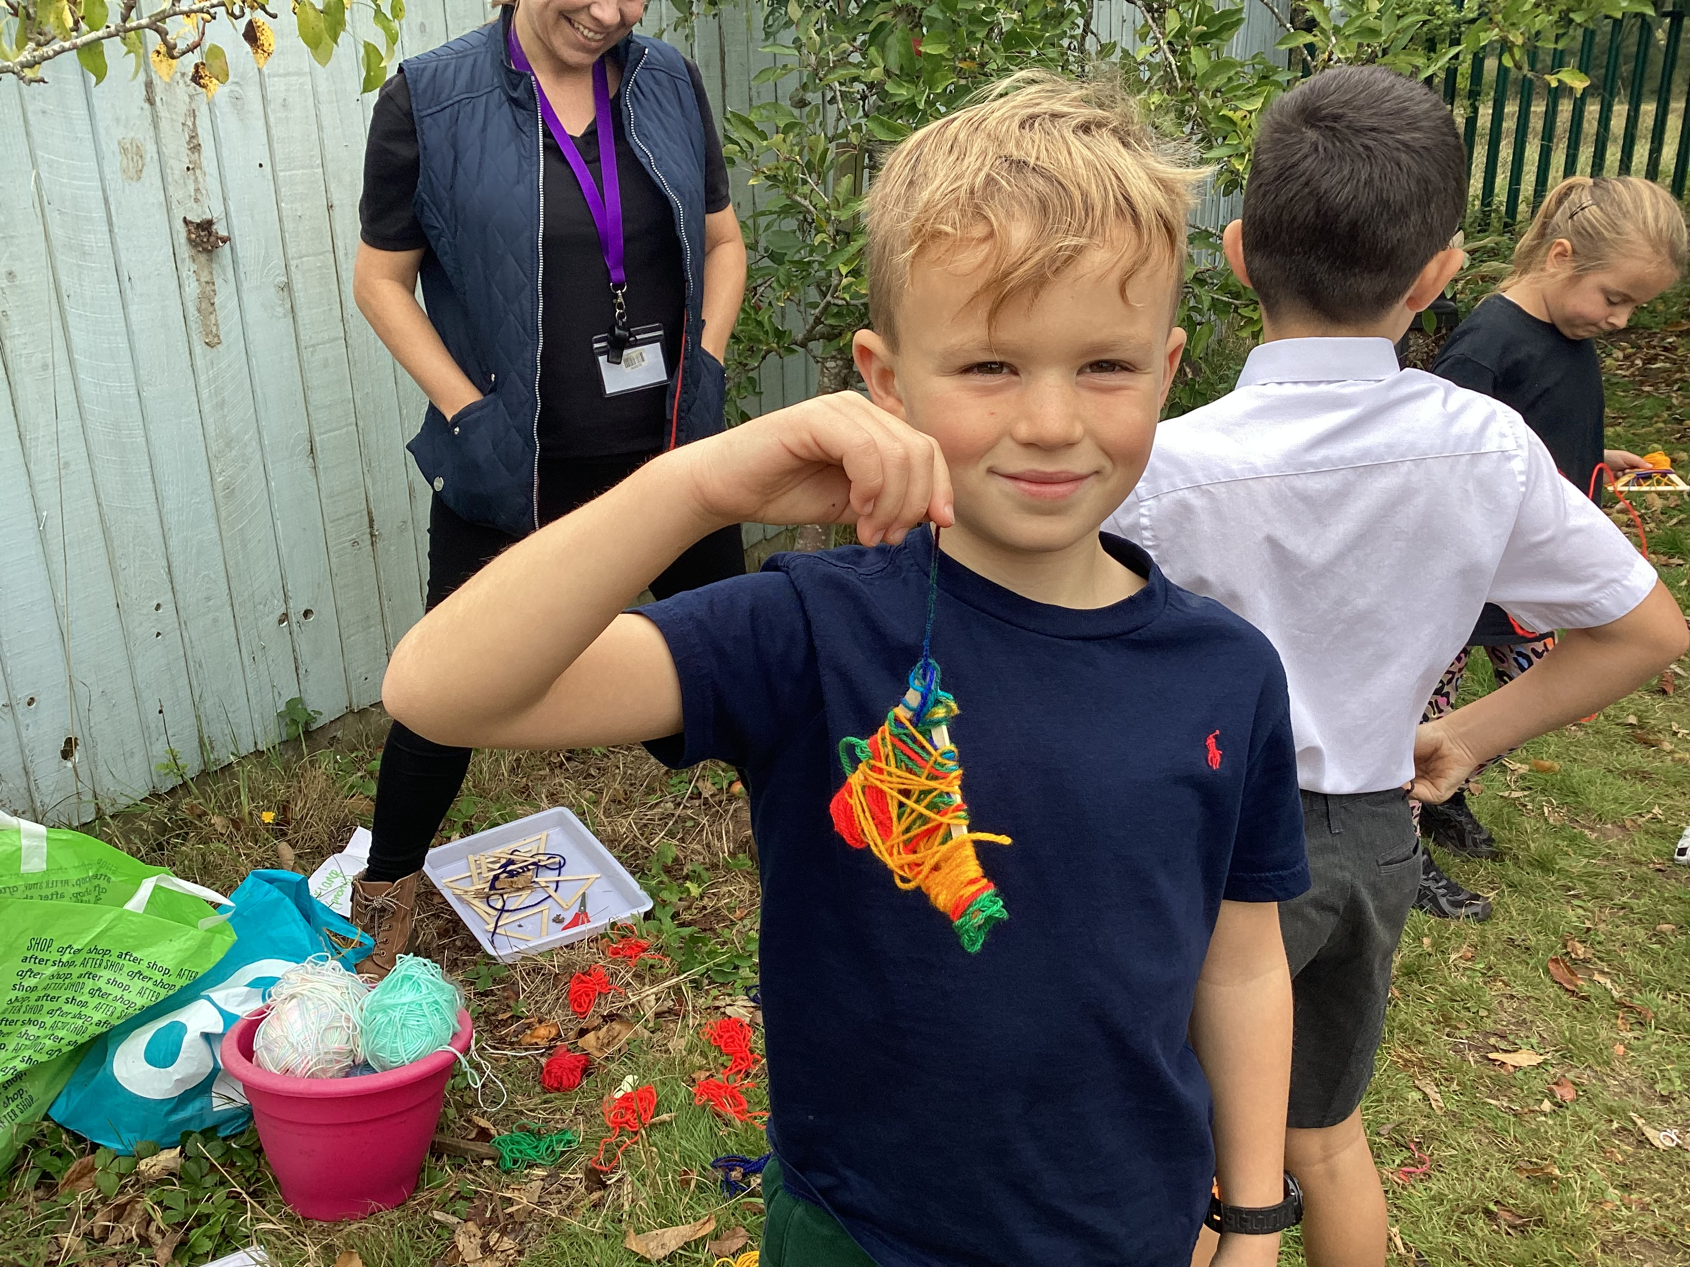
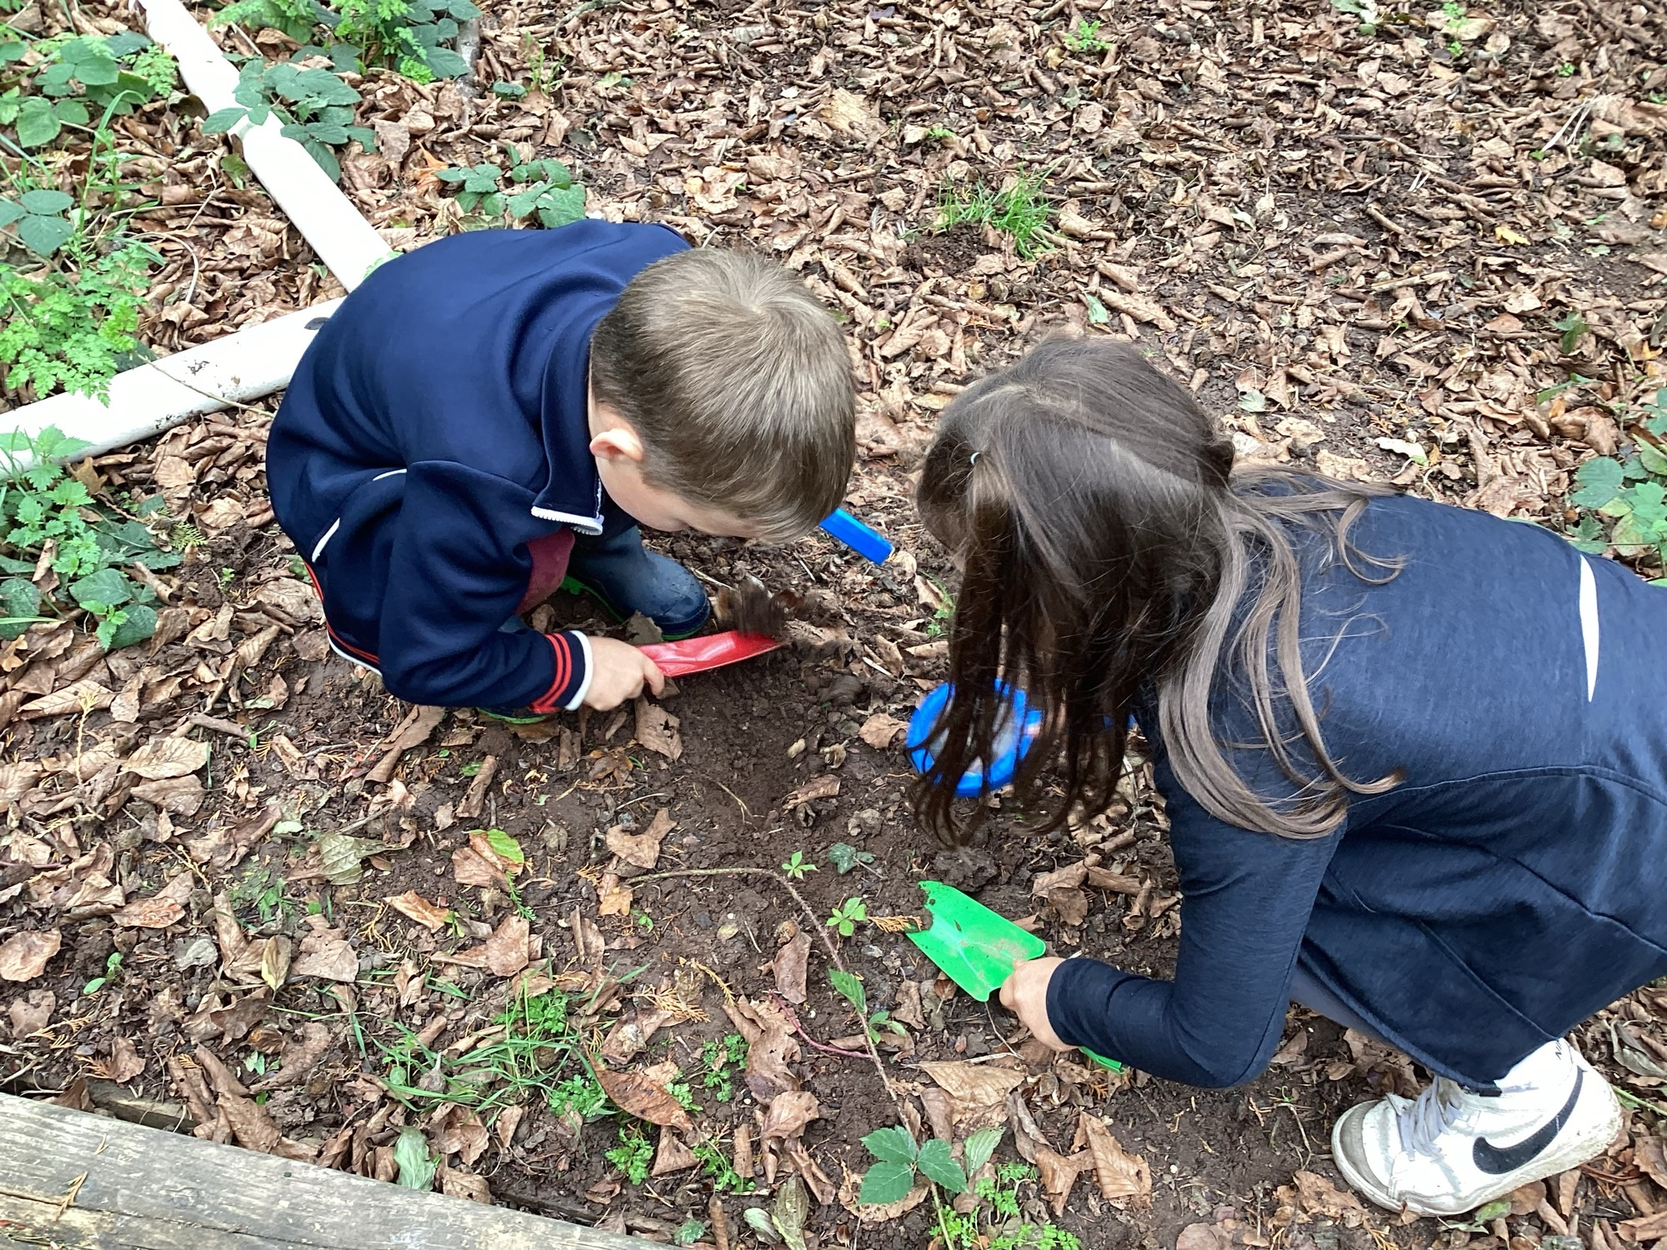

Slide 12
