Slide 1
Menti

Slide 2
Anti Bullying update
Highlights:
98% of children feel safe at school 94% of children feel like adults deal with bullying well (63%) or quite well (31%)
98% of children think teachers would help children worried or sad about bullying
93% of children would tell an adult if they were concerned about bullying
97% of children would help someone being bullied
Areas for action:
34% of children say that they have been bullied a little (28%) or a lot (6%) this school year
32% of children say they have seen a little (27%) or lots (5%) of bullying
28% of the bullying seen or experienced is made up of ‘physical’ ‘verbal’ or ‘hidden’ bull

Slide 3
Assessment update

Slide 4
RE – Staff Meeting
Monday 6th December

Slide 5
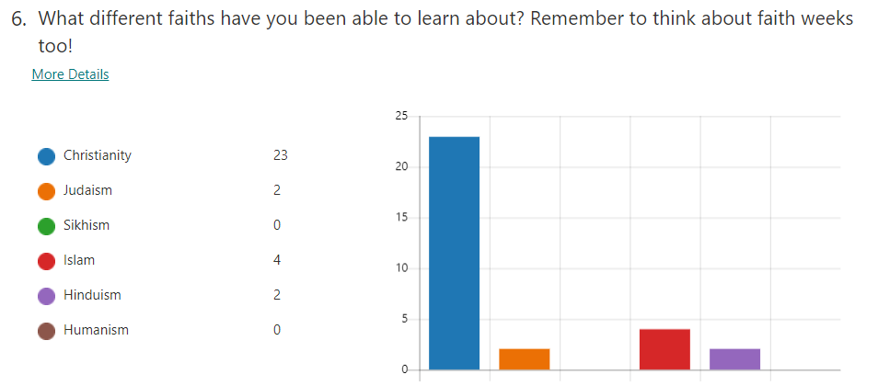
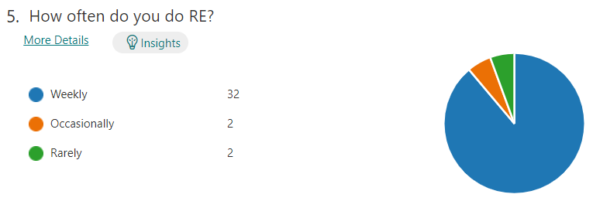
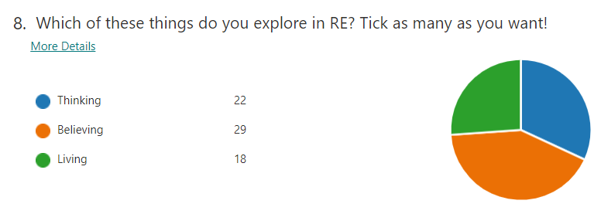
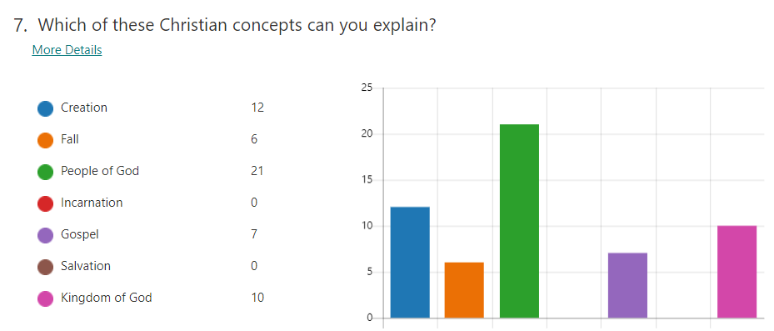
Where are we at - Pupils

Slide 6
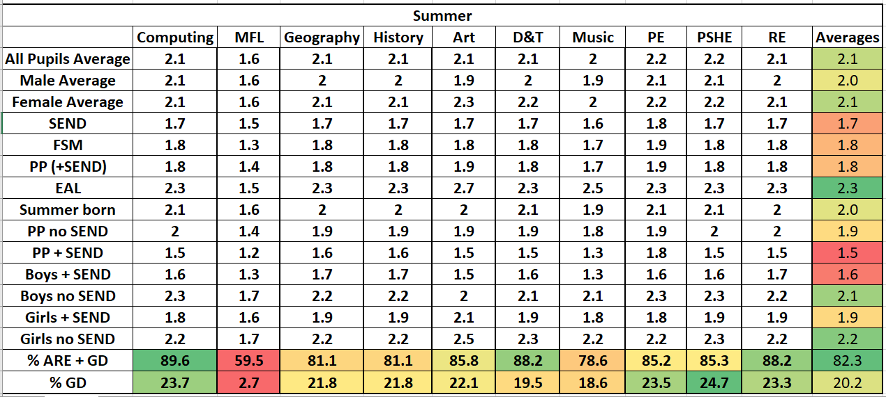
Where are we at - Data

Slide 7
Where are we at - Books
Some great examples of work in most year groups.
Good evidence of a range of types of RE.
Ranging quality – some scruffy unchallenged work
Assessments?
Regularity of work is an issue – from 2 pieces to 13 pieces of work!

Slide 8
What’s the intent
Religious Education at Meriden CE Primary School provides a safe space for children and adults to explore their own religious, spiritual and philosophical ways of believing, thinking and living.
​
With a focus on Christianity, as well as a range of religions and world views, we nurture respectful attitudes through meaningful, informed dialogue. With inclusivity at its heart, children of all faiths and none, develop a strong sense of belonging. Through varied and wide-ranging curriculum experiences, our children have the opportunity to take hold of the treasures of faith. Our children become inquisitive, analytical, resilient and reflective learners as we lay the foundations for their continuing spiritual journey.

Slide 9
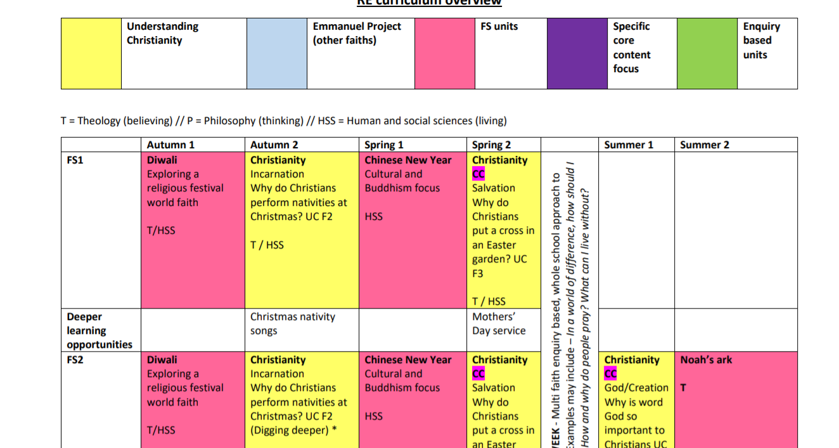
The curriculum changes

Slide 10
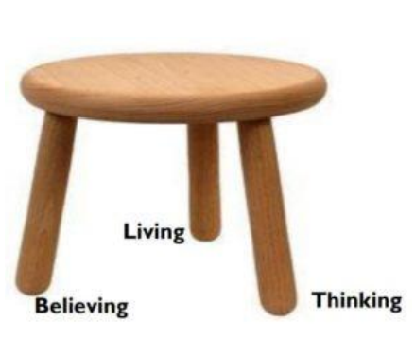
Balanced RE
Theology
Believing
Philosophy
Thinking
Human and Social Sciences
Living

Slide 11
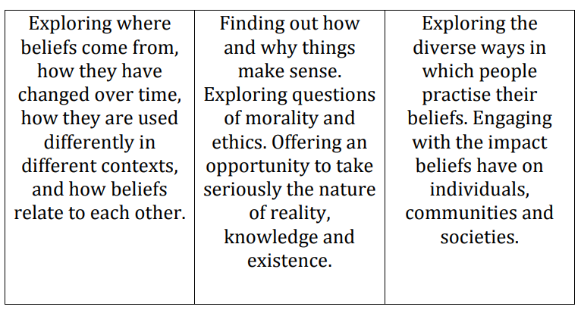
Balanced RE
Theology
Believing
Philosophy
Thinking
Human and Social Sciences
Living

Slide 12
Balanced RE Back to menti

Slide 13
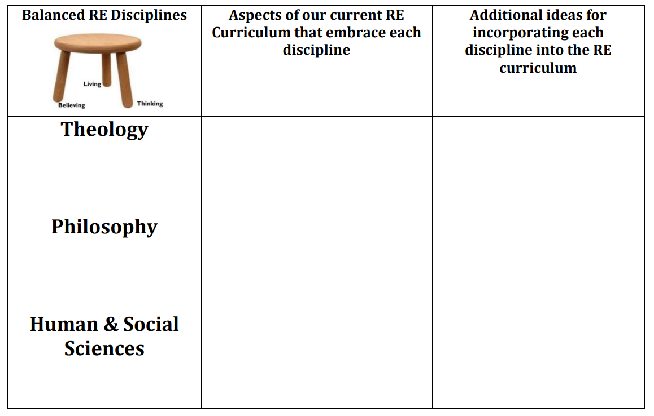
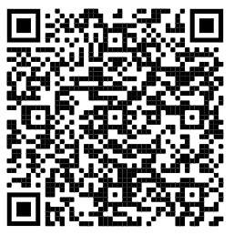
Balanced RE – Work books

Slide 14
Balanced RE – lenses
Handout – we are…

Slide 15
Balanced RE – Big questions!
A – Who made the world?
B – What is the white stuff?
C – Where is England?

Slide 16
Balanced RE – Big questions!
A – Why doesn’t everyone fall off the bottom?
B – How many people live on this planet?
C – It looks so beautiful from here – is it beautiful close up too?

Slide 17
Balanced RE – Big questions!
A – If God made this, is he pleased with it?
B – What is holding it up?
C – Why are some parts of the earth cold and others warm?

Slide 18
Balanced RE – Big questions!
When trying to answer these questions, do pupils know where their ideas are coming from? Are they drawing on theology, philosophy or their knowledge of human behaviour and practices?

Slide 19
Miniature earth – an enquiry
Ask Questions
Stimuli
Ask
Investigate
Suggest meaning
Evaluate
Critical
Express
Analyse
Evaluate
Sort ideas
Make links
Reflect
Personal
Express
Apply

